Slide 1




FJYPB Update
Cafcass Board Meeting 07.07.2021

Slide 2
What have we been up to?
We have recently submitted our business case to the MoJ for our website. We are keeping our fingers crossed that we will hear back soon with good news!
FJYPB members Malak and Lisa visited the Coram site where we will be hosting our 10th anniversary celebration event in August. We have sent out save the dates to our members, as well as Cafcass staff who we have worked with closely over the years.
Planning is well underway for our annual Voice of the Child Webinars 2021! A series of webinars will be held aimed at professionals throughout the October half term, as well as a webinar for Children in Care councils. The theme will be on the topic of communication and language.
We are continuing to gather our experiences for the FJYPB book. Two further workshops have been confirmed with Dawn Reeves who is helping us write the book. We hope to launch the book in September to mark our 10th anniversary month.

Slide 3



‘TOGETHER’

Slide 4
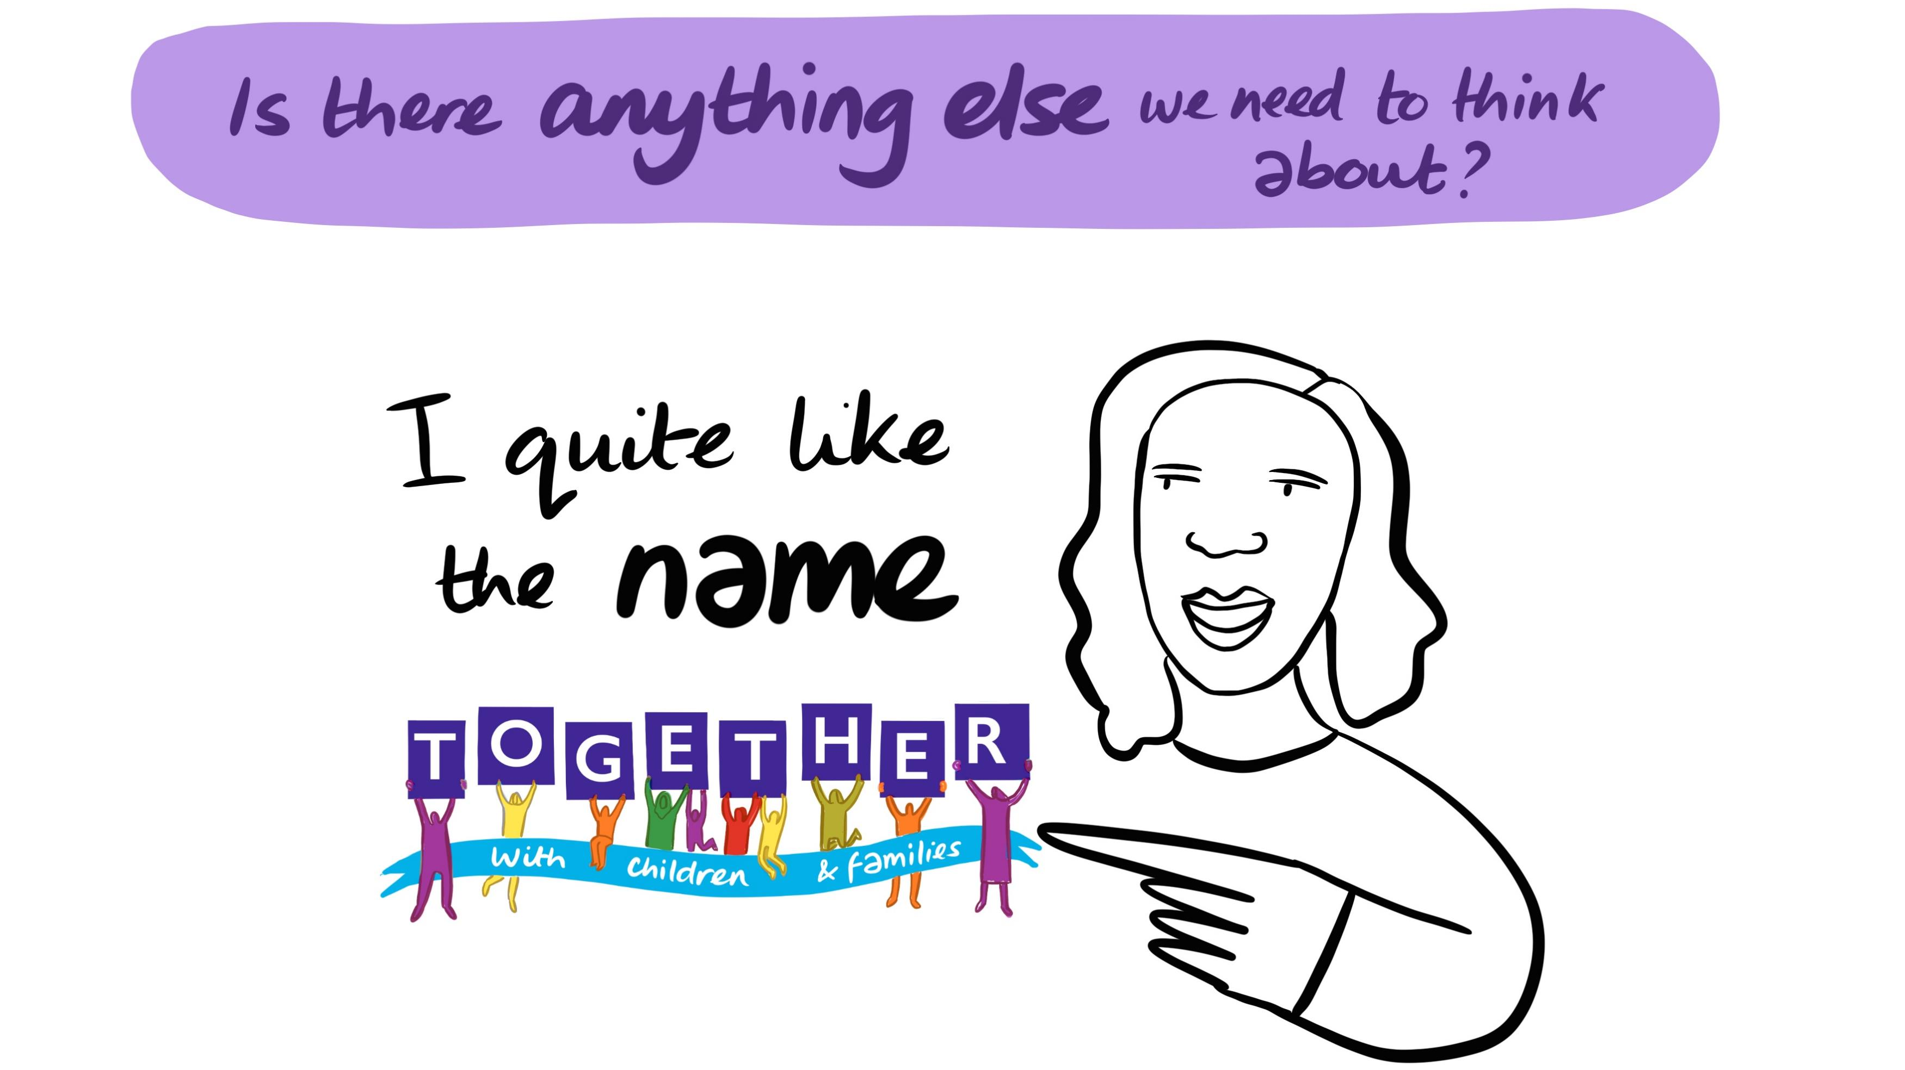

Slide 5
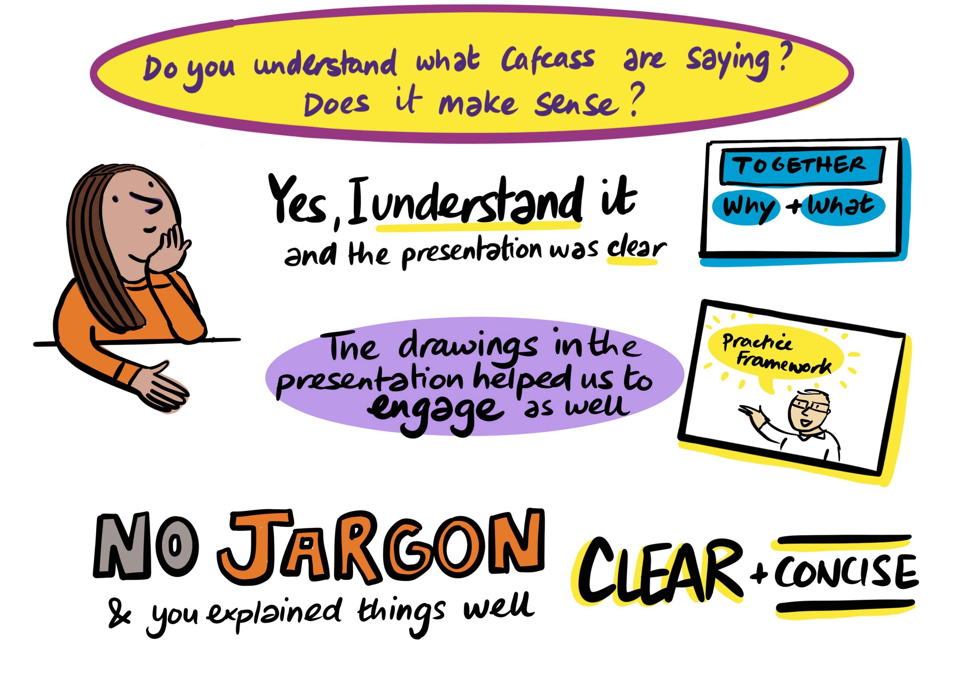

Slide 6
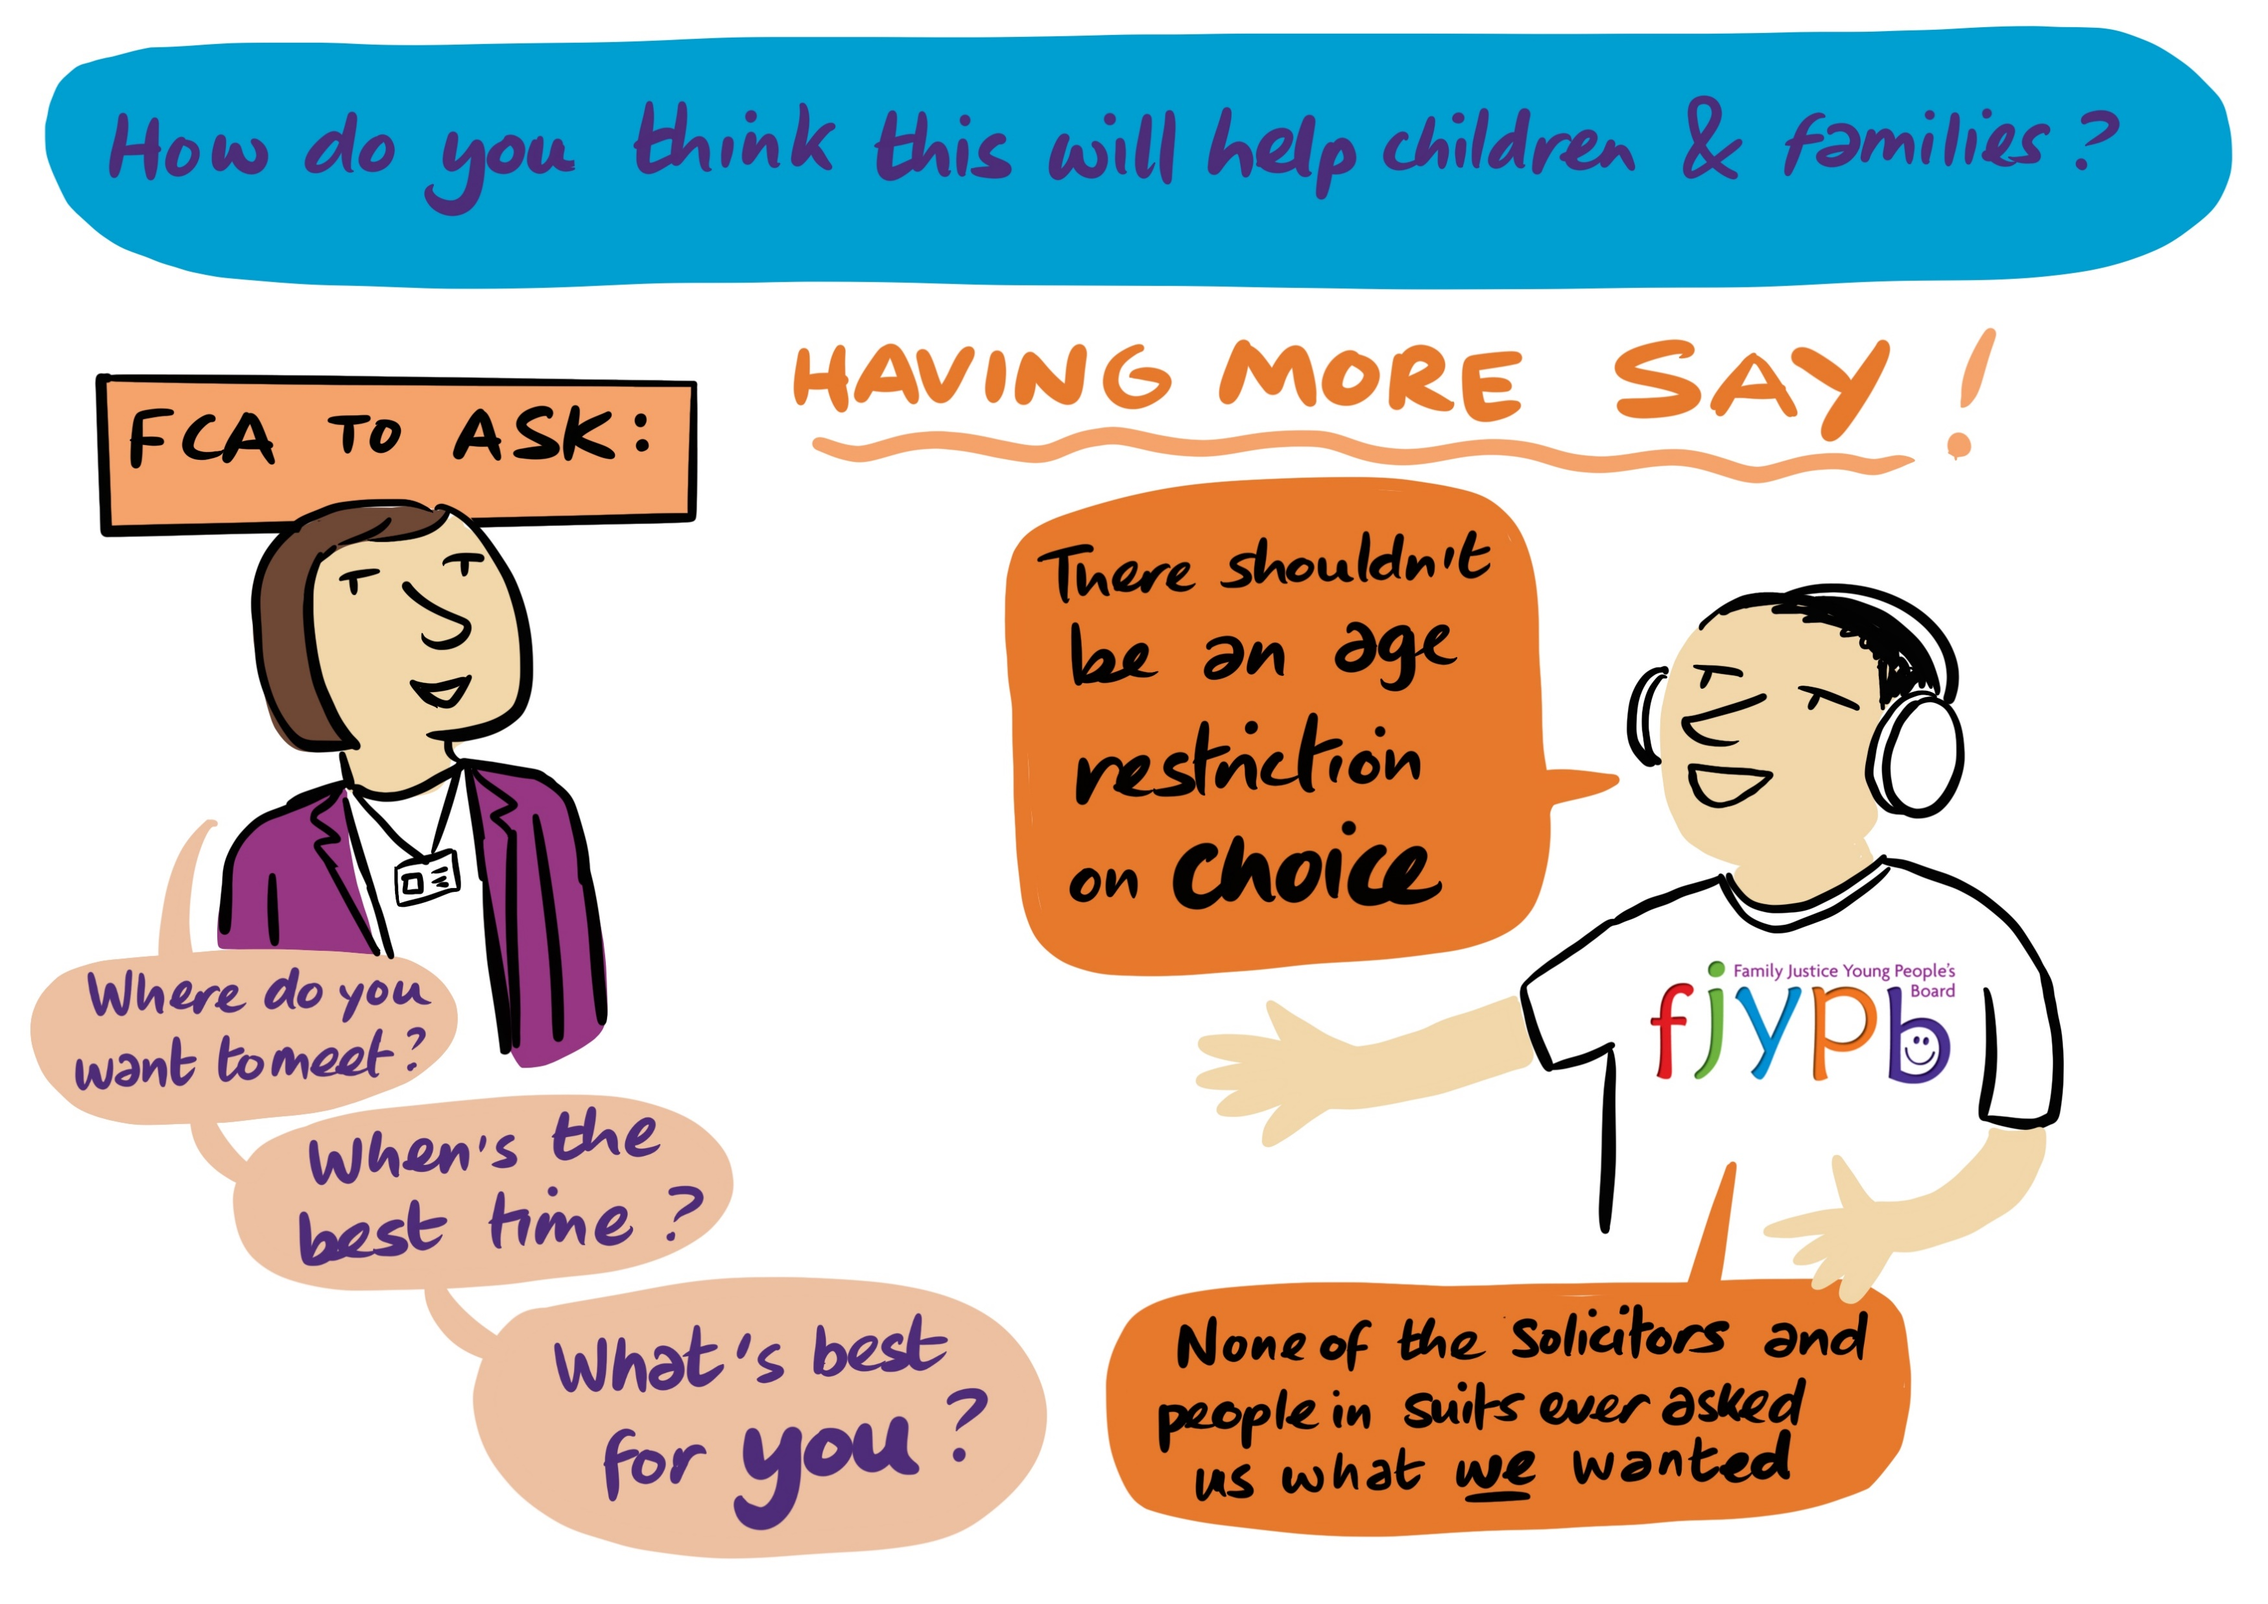

Slide 7
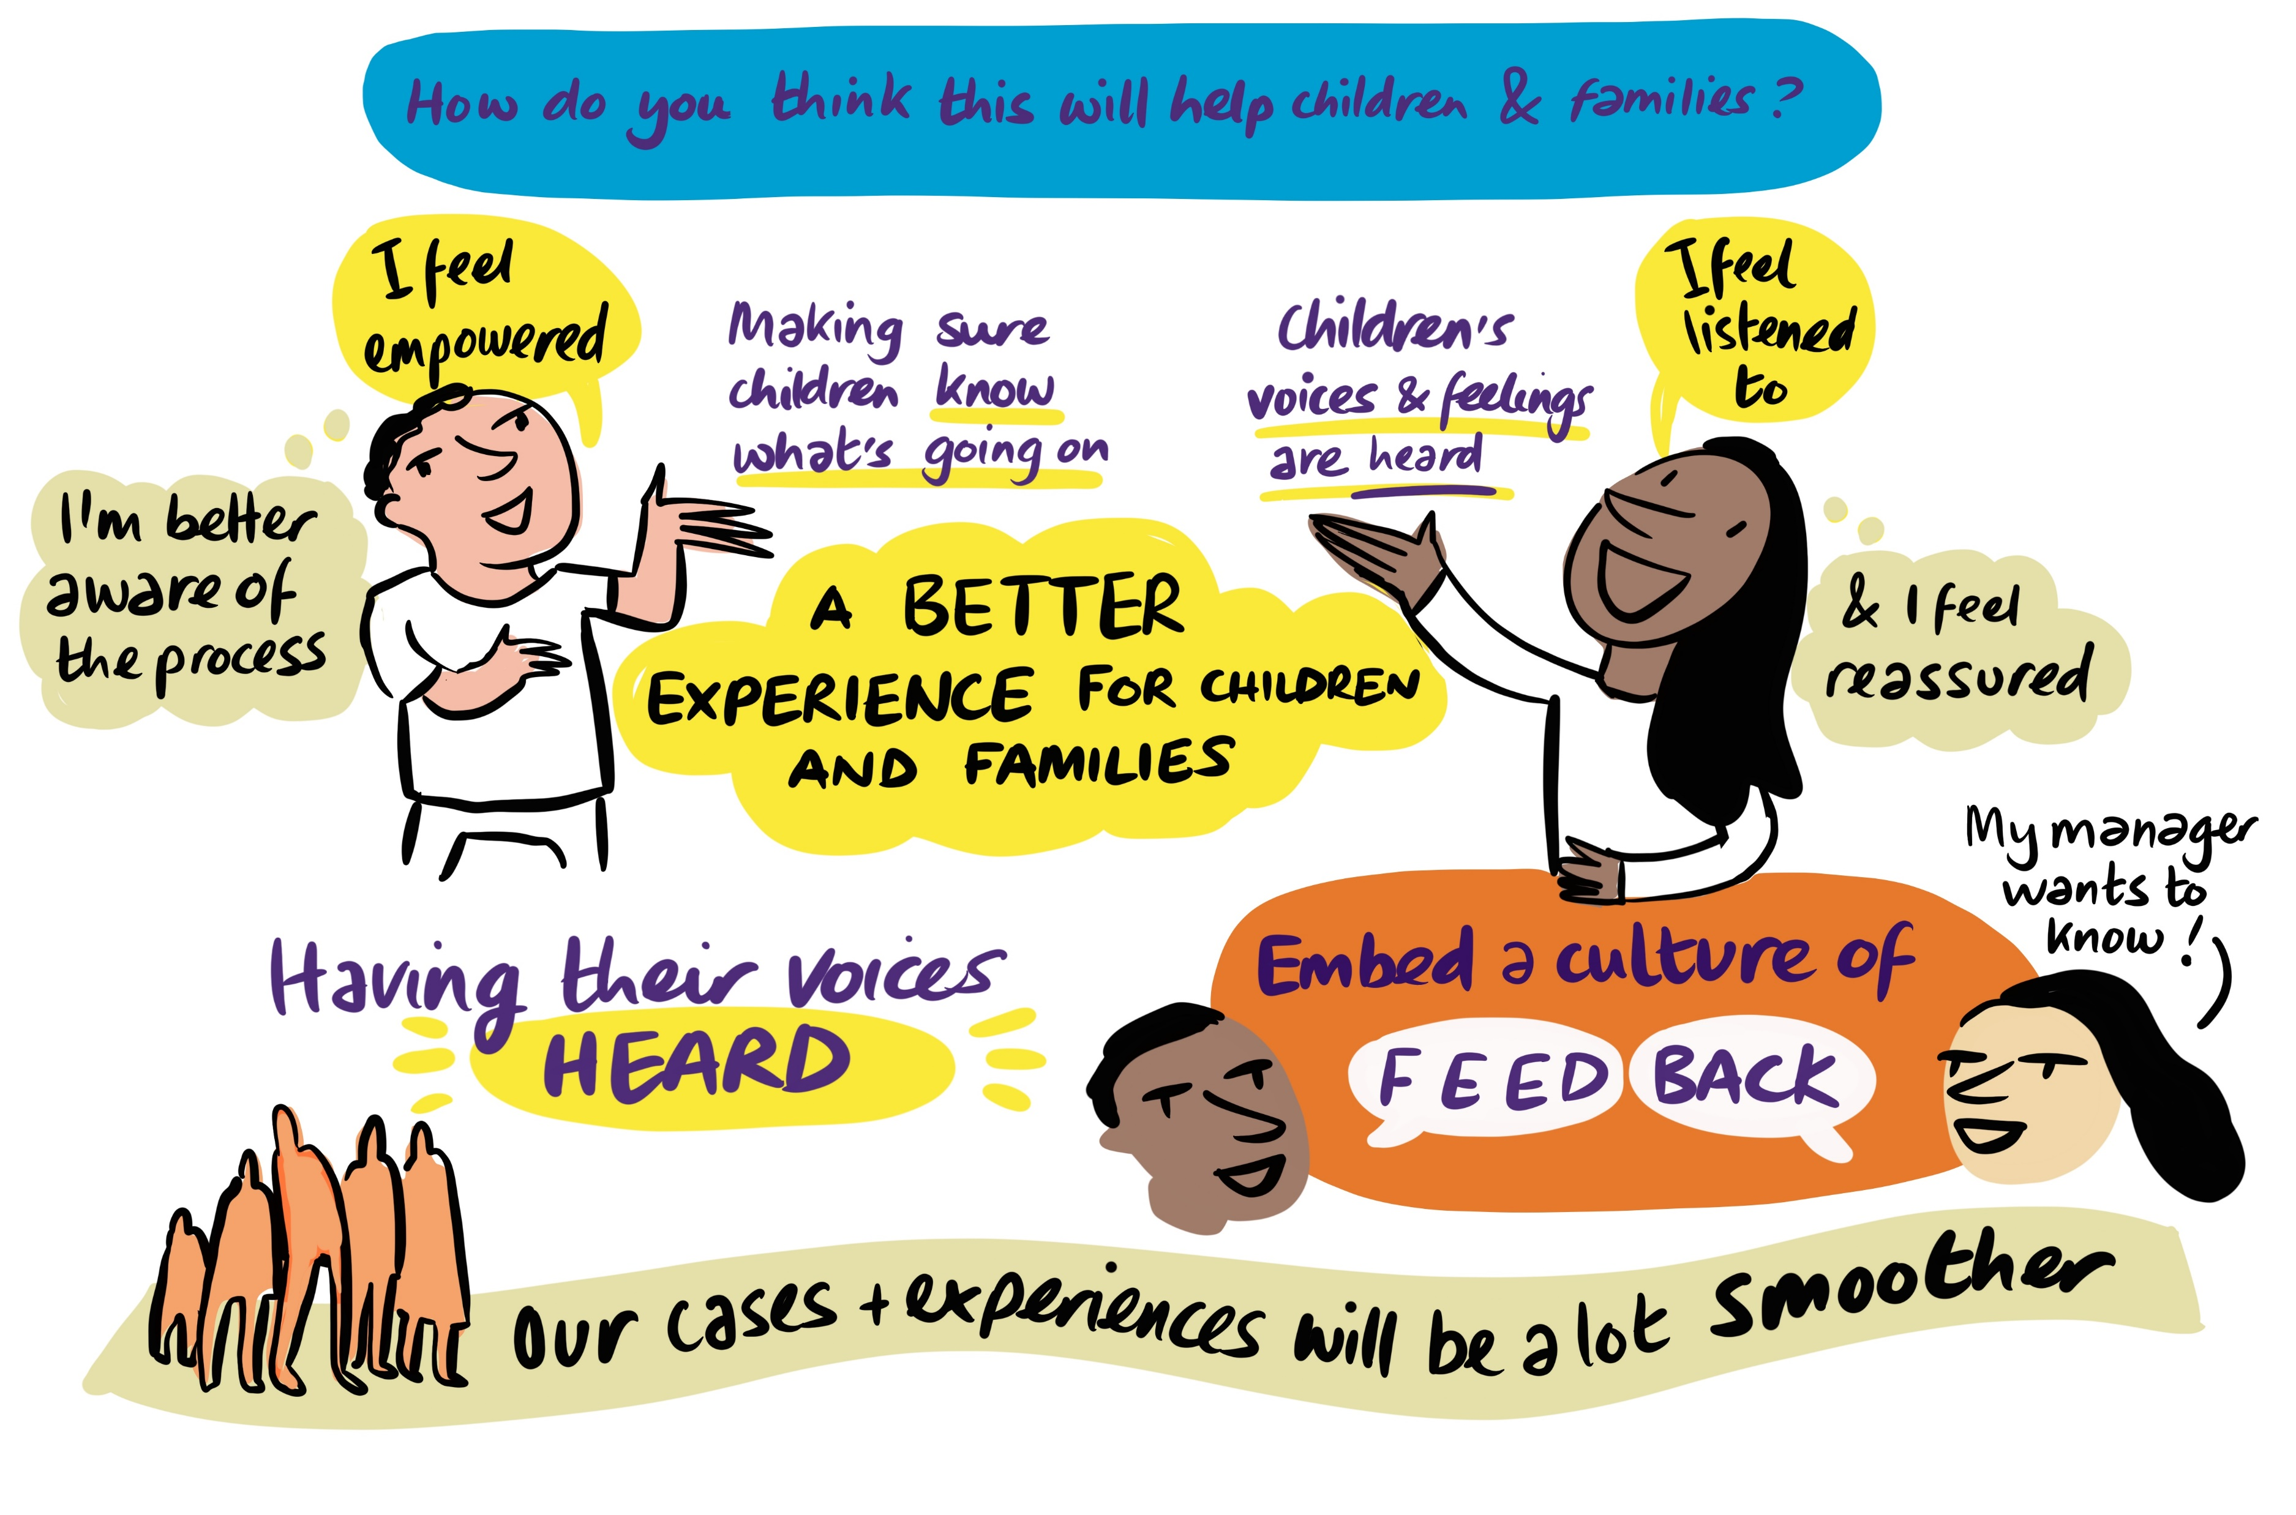

Slide 8
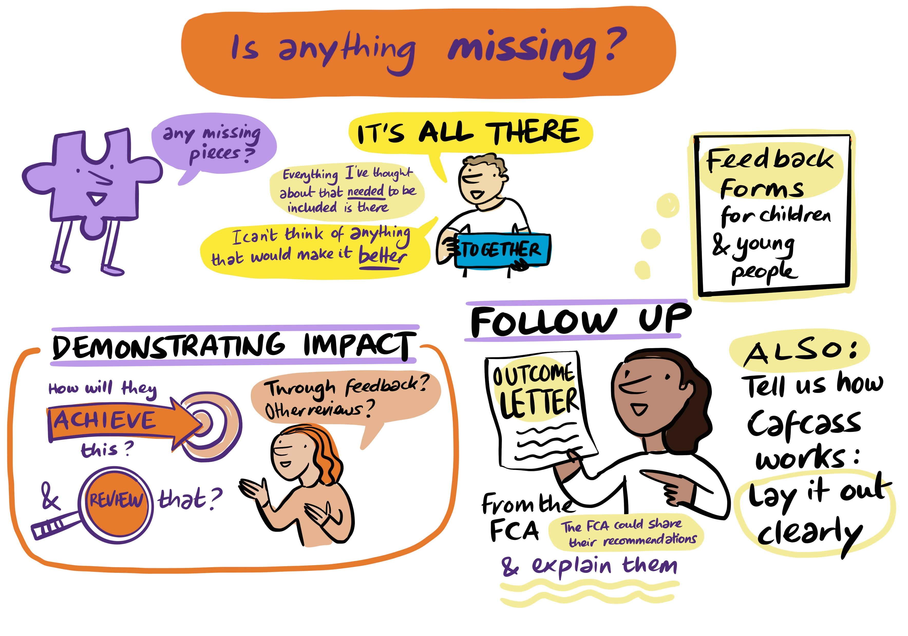

Slide 9
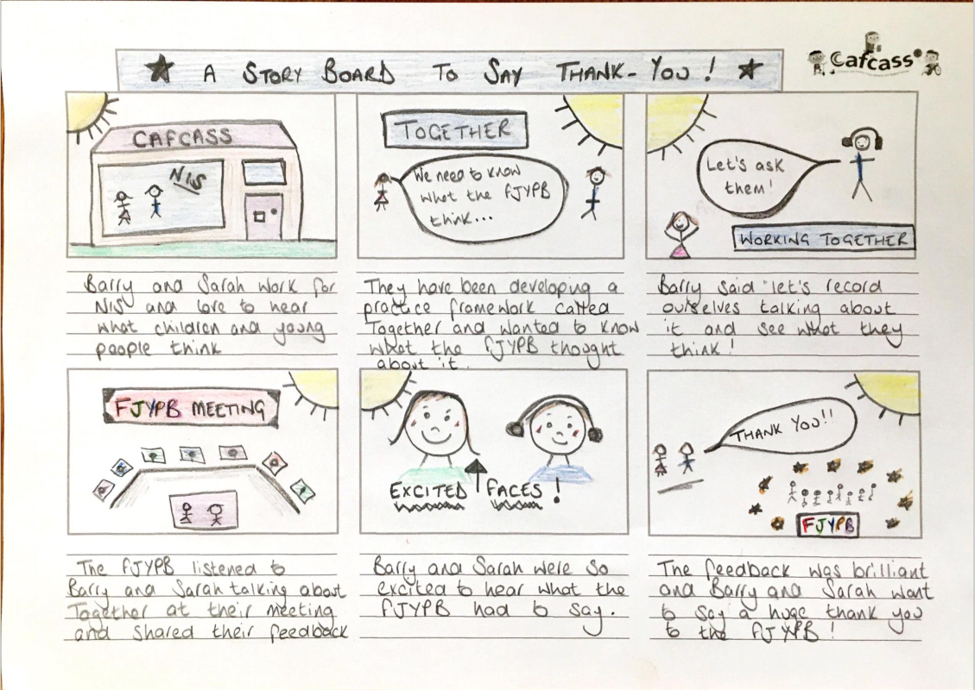

Slide 10


Word Busting

Slide 11
Word Busting
Our aim is for all people working in family justice including staff to use more child friendly and jargon free language when speaking to or writing about children and young people. We want staff to use plain English, with simple explanations, and to provide enough information to each child so that they fully understand the role of Cafcass and what happened to them during their involvement with the family courts.

Slide 12
Actions Identified
To develop a word busting team including members of the FJYPB and Cafcass staff to identify the top 20 words to change. We want to identify two words per month for staff to replace with a more child friendly word or phrase. We understand that in some situations and in official publications more technical or professional terms will be retained.
To investigate with Cafcass IT if a ‘word check’ alert could be available on the child’s file or report when using ‘busted’ words.
To consider screen savers to include the top words to avoid and have them presented on display boards in Cafcass offices.
The welcome letters to children and young people to include the FJYPB glossary of terms.

Slide 13
What we have achieved so far
We have developed a leaflet with a list of terms that we have identified as not being child friendly or that should be explained further to children and young people.
We have already had several Cafcass staff volunteers to join the word busting team and will release our first busted words in July.
FJYPB members have identified words that they would like to see changed or stopped being used when writing about or talking to children and young people.
The FJYPB members were invited to take part in a competition to create a mascot for the word busting team that can be used by Cafcass to raise the awareness of the monthly busted words. The Cafcass Communications team now have these design entries and deciding on the official design. There is also a prize for the top 3 entries.

Slide 14
Jargon Words identified by FJYPB members
Section 7s
16.4 report
Third party
Connected Children
Public/Family Law
Guardian
Siblings (better if it's brothers and sisters)
Connected siblings
Third party
“Problem child”
Order
“Classic case”
Non subject child
Split family
Mediation
Child Looked after
Look after child
"Behaviour issues"
Case file
Child in care
Subject Child
Public or private law
Caseload
Fantasy world
Case
Kids
Spectrum
Access
CYP
Beyond parental control
CIAF
ICO/ISO
LAC

Slide 15
Examples
Can you imagine how it might feel to hear this being spoken about me or to even read this in my file or in court reports?
It is better to explain what has been observed and to offer reflections on why I may be reacting this way.
Behaviour issues
Beyond parental control
Problem child

Slide 16
Our challenges to you…
We want you all to think about two words that you use that may not be clear or understandable to all.
We want you to now think of other words you could use to make the meaning of the words clear.
Please share some of these examples with us….

Slide 17
Upcoming work
We will be hosting a workshop in August for children and young people representatives from Hertfordshire, Essex and Sheffield to create a universal fact sheet for children when they enter care proceedings.
We have been invited to attend the Cafcass Cymru Advisory Committee meetings going forward and have recently met with Nigel Brown to discuss our contribution.
FJYPB members Ayla and Marina have been hosting workshops to discuss content ideas for a PHSE lesson on family relationships and family justice. We will be presenting this to the DfE at our catch-up meetings to share in schools.
Following our oral discussion with the President of the Family Division in May, we once again have been looking at transparency within the courts, following the report published by CORAMBAAF on the anonymisation of children’s judgments in cases involving sexual abuse being on BAILLI, a public website. We will be presenting at the roundtable discussion on 13th June to give our views directly to senior judges and professionals in response to the report.

Slide 18
Get in touch!
We would love to hear from you. To contact us, please email FJYPB@cafcass.gov.uk

