Slide 1



Cafcass Board Meeting – 21 October 2020
Chief Executive’s Overview

Slide 2





COVID – 19, impact data and backlogs
Practice
Seeing children - KG
Returning to court and opening offices - KG
Learning and Improvement Board - TW
Quality of Casework – AO
Family Forum – TW
Covid – 19 Overview -JT
Data - JT
Immediate actions to relieve pressure and prioritisation - AO
People
Partners and organisation
Staff surveys and feedback - NG
Securing additional staff - NG
Equality , Diversity and Inclusion – TW
Recovery planning – JT
Priorities for reform - TW/JT
Public Law Snapshot
Ofsted - JT
Budget overview and comprehensive spending review - JB
Annual report – MH
Three year strategy - TW

Slide 3
COVID – 19, impact data and backlogs
Covid – 19 Overview -JT
Data - JT /BR
Immediate actions to relieve pressure and prioritisation – AO

Slide 4
Covid–19 Overview JT
  Covid Programme Board – continues to meet weekly – MoJ represented through Alison Wedge – Partnerships Director for ALBs
  An essential business– emphasis on seeing children and families again in COVID – secure workplace, strong risk assessments for visits and open offices for all staff
  Strict observance of govt guidance – local lockdowns do not change our position
  Tension – productivity versus in person work for everyone
  Absence data still low for Covid
  Morale, demand and low throughput of cases through courts remain the most significant and pressing issues – ongoing pressure on managers also carrying casework – for first line managers – 50% more and for second line, it is creeping up 25% lead allocation
  Backlog handling relief – constant leadership loop
  Capacity tool available to establish where existing staffing compromised
  Quality of practice and seeing children is a leadership priority. Monitoring levels of children seen face to face. New curiosity and leadership of new risks from COVID
  Pace on a long road – the pressure and uncertainty won’t abate for Cafcass – leadership/planning/feedback/adaptative and fluid
  Good news - £3.4m emergency allocation in August!!! – pressure dropped instantly. We were at critical.

Slide 5
Data on demand: JT
  Number of children and families with cases open to us continue to increase and are at record levels due to the continuing reduced capacity and backlogs in the family courts
  The latest financial quarter (Jul - Sep 2020) saw the highest new case demand for a financial quarter on record. Case closures in the same period fell by 20% compared to Q4 2019/20 (Pre-Covid19)
  At 12 October, there were 36,625 open active cases (where there is known future work for Cafcass). This increases on average between 100-300 cases per week
  The volume of open active work is +19.4% / +5,959 cases compared to October 2019. This breaks down to an increase of +16.7% (+1,986 cases) for public law and +21.2% (+3,973 cases) for private law
  Since 1 June 2020 Cafcass’ total active children’s caseload has increased by an average of 90 children per working day
  National average caseloads for work after first hearing are now 24.2 cases, with 75.5% of qualifying staff holding > 20 cases. For private law case work before the first hearing, caseloads average 56.4 due to increased delay in hearings

Slide 6
Data on demand: JT (2)
  Cafcass front line managers are playing a key role in keeping FCA caseloads at the current level. The overall average caseload of Cafcass Practice Supervisors is 18.1 cases, including both duty and substantively allocated work.
  Throughput of work (new cases being received compared to cases being closed) continues to be low. Public Law (Care) closure rates have decreased by -19.8% and private law closures -14.6% in August compared to July
  In Public law work, active cases with a duration above 36 weeks are +48.5% (+1,076 cases) compared to February 2020 (Pre-Covid19)
  To date 52% of open cases (public law / post FHDRA private law) have had a ‘child seen’ record added. This follows a system change in June 2020 to actively record this as a stand alone data item.

Slide 7
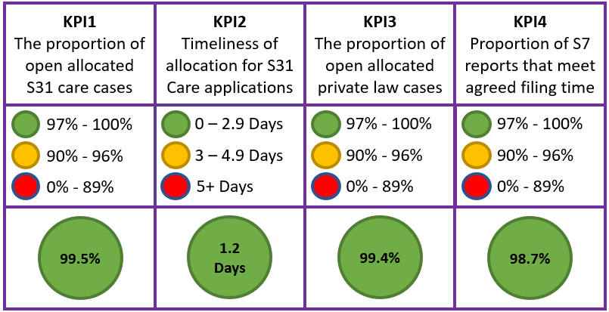
Performance against targets : BR

Slide 8
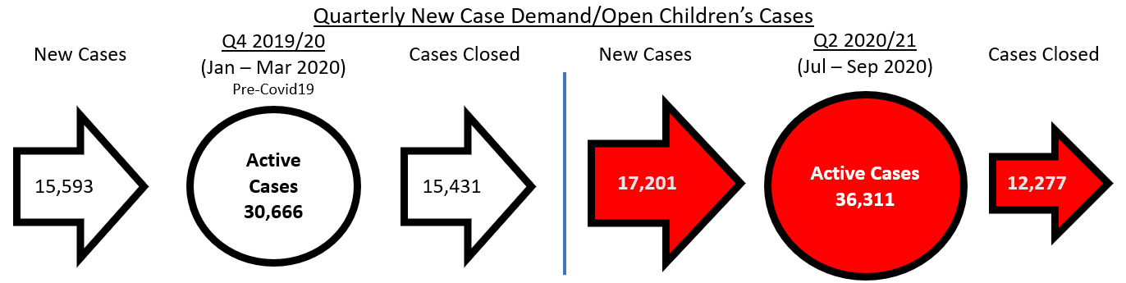
Performance against targets : BR
Cafcass is currently maintaining organisational performance against KPI targets for the safe allocation of work, and for the timely filing of Section 7 (S7) reports in private law cases.
Record demand and reduced system throughput are contributing to a high risk that Cafcass will be unable to effectively allocate new work in some areas within 8 weeks.
Associated with record levels of both demand and open cases, there is a risk that the quality of work could be impacted should the overall level of open work remain as it is today.
The two slides that follow set out clearly the cost and risks of our continual allocation of work coming to Cafcass.

Slide 9
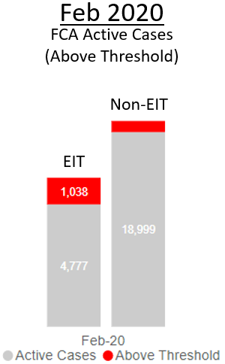
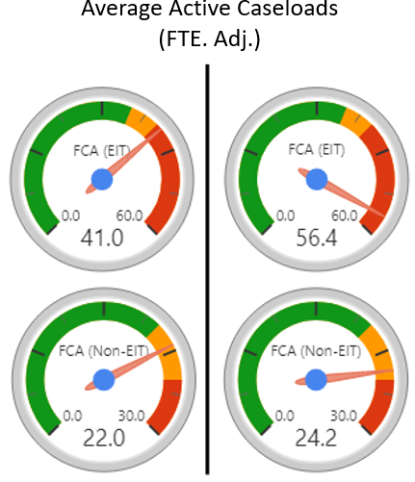
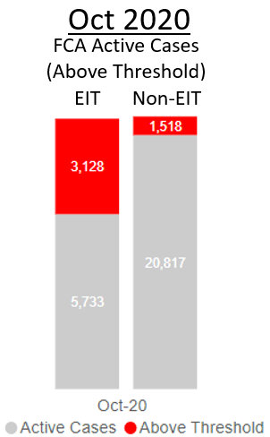
Performance pressures : BR
We currently have 4,600+ cases allocated to FCAs above our threshold for high caseloads
There are currently 1,600+ cases lead allocated to Practice Supervisors, with 68% of this staff group holding ‘above threshold’ caseloads for their role.
In our early intervention teams, the caseholding social workers with the top 10% of workloads carry an average of 91.7 active cases, (compared 72.7 in February 2020 for the same measure)
In our work after first hearing teams, the caseholding social workers with the top 10% of workloads carry an average of 39 active cases (compared to an average of 36 in February 2020 for the same measure)
2,114 additional active cases allocated to FCAs already ‘above threshold’ for high caseloads.
(>40 EIT / >25 Non-EIT)
4.646 additional active cases allocated to FCAs already ‘above threshold’ for high caseloads.
(>40 EIT / >25 Non-EIT)
1,076

Slide 10
Performance pressures: BR
  Cafcass continues to achieve KPI4, although the number of S7s filed by the first agreed date is a much lower figure (72.3%). This means we file on time but with agreed extensions
  S7s being ordered by the courts increased by 2% in the last financial quarter compared to pre-Covid19 levels (Jan-Mar 2020).
  S7s being filed by Cafcass reduced by 20% in the last financial quarter (Jul-Sep 2020) compared to the same period.
  Addendum reports being ordered by courts (not the first S7 on the case) increased by 16.4% in the last financial quarter compared to Jan-Mar 2020 (pre-Covid19), indicative of lengthening proceedings and increased work for open private law cases.
  There are currently ~1,900 C100s with HMCTS, when the applications are received they will equate to approximately 35-40K hours work for Cafcass social workers over the case lifecycle, the equivalent of ~25 FTE p.a. social workers (~£1.3M).
Quarterly New Case Demand
S7 Ordered
Q4 2019/20
(Jan – Mar 2020)
Pre-Covid19
S7 Filed
S7 Ordered
Q2 2020/21
(Jul – Sep 2020)
S7 Filed
5,320
5,572
5,423
4,366

Slide 11
Immediate action to relive the pressure: AO
  Prioritisation of casework not triggered yet. Mitigated for between 4-8 weeks in most regions by:
  £3.4m additional overspend capacity for staffing – locums, permanent and associates
  New temporary agreement with Judiciary to close work to Cafcass once safeguarding letter filed and after section 7 report completed
  National hub to support section 7 reports where the issues are less complex
  Early impact of new practice direction (36Q) reducing need for first hearing where a section 7 report is obviously required
  Assistant Directors (with operational director oversight) self- assessing fortnightly and submitting to COVID board. Narrative provided with assessment on likelihood of triggering non allocation of new work considered to be lower priority
  Probable timeline for next pressure point nationally is January 2021with likely trigger at the point in some if not all regions

Slide 12
Practice
Seeing children - KG
Returning to court and opening offices - KG
Learning and Improvement Board - TW
Quality of Casework – AO
Family Forum - TW

Slide 13
Seeing children: KG
  The importance of our staff seeing children and their families as our first responsibility remains a priority for us to oversee and monitor
  Children have been seen in person when not in best interest to seen remotely. This is risk assessed on a case by case basis . We are monitoring the impact of COVID – 19 on this work carefully
  Children seen data since June shows 53% recorded as seen using new measurement tool and of those 30% seen face to face
  Checks and balances in place include:
  Regular reviews of data performance using measurement tool
  Use of drop down menus on CAFIS database to specify in what locations children are seen.
  Use of Powerbi system to review at area/team and individual staff levels.
  Monitoring of use of risk assessment forms.
  Regular communication with staff on importance of seeing children in most appropriate way.
  Senior leaders engagement with staff groups on regular basis via OMT/SAM’s and specific discussions

Slide 14
Seeing children: four case studies - KG
  13 year old young person subject to private law proceedings – the CG had been involved previously and proceedings had taken around 2 years including an expert assessment. This time they were resolved in 3 months as the CG saw the child remotely and was able to engage him. The proceedings concluded promptly and in the child’s best interests despite the complexity. The CG commented that she was able to build a completely different relationship this time as she remotely saw the child more than she’d have ever been able to face to face
  FCA picked up a case from another FCA away unwell . It was public law and the child was living with foster carers. The LA weren’t completing any assessments or complying with orders – the Judge commented that the CG had in the 2 weeks she’d been allocated completed more work than the LA in 6 months. This was all completely remotely and ended with the family complimenting the CG for her work on the case
  Private law remote engagement with child – FCA felt something wasn’t right so decided on a face to face visit. Found a child chronically neglected. Local authority sought EPO on same day
  Private law – remote engagement about contact with father – 11 year old child. Hard to engage remotely – said he wasn’t bothered about seeing dad. FCA recommended continued indirect contact. Judge asked for additional work with child. FCA took letter from dad and read it with child who was curious about contact. Changed recommendation to the court to contact through a centre to see how well this will work.

Slide 15
Returning to court and opening offices: KG
  The most recently available data shows the total number of hearings in 2020 to date that Cafcass had an involvement has recovered to an expected level, indicative of a significant increase in the last quarter.
  The listing process remains under pressure with 16.7% of cases listed for a date more than 12 weeks ahead. The large majority of the hearings listed in 12+ weeks are Final hearing or Fact-Finding hearings. HMCTS throughput of cases remains slower than previously with an impact on Cafcass’ throughput of casework and therefore caseloads
  The use of remote hearings continues to be in place in the majority of cases and locations. The priority remains that the parties to the case have the opportunity to attend court rather than professionals through the hybrid approach introduced early in the crisis. We continue to review carefully our presence in court to ensure that we attend in person when necessary
  16 priority offices are all now open, COVID- secure and providing facilities to support children and families. Staff can use offices on a bookable basis to work and to see children in person
  All remaining offices to open by end November 2020
Notes:
Updated

Slide 16
Learning and Improvement board: TW
  Our practice and leadership response to the issues raised in MoJ Expert Panel into harm in the family courts – June 2020
  Introduces external scrutiny, challenge and collaboration – feels good, still learning
    External Chairs - Cathy Ashley & Angela Frazer Wicks (Family Rights Group)
    Membership - includes experts by experience, and organisations which represent them
    First meeting of Learning and Improvement Board 17 September, Terms of Ref published
  Now scoping the Learning Review
    baselining audit – October - December (c200 cases with domestic abuse a feature)
    Practice observations & focus groups
    Moderation led by Professor Eileen Munro and supported by 3-4 external Learning & Improvement Board members
  Will inform Learning and Improvement Plan to be agreed Jan 2020. Progress against plan to shared externally: Interim report (Summer 2021) Final report with action taken and impact (by Spring 2022)

Slide 17
Quality of casework : AO
  Quality Assurance Data: so far no audit evidence of reducing quality though there is inevitable risk from rising caseloads, reduced oversight given pressure on managers, impact of seeing children remotely and delayed proceedings. Mitigator – more productive hours due to less travel
  2. Additional assurance activity:
  A quality audit of 200 live cases – including domestic abuse practice
  ‘Children Seen’ Audit: 200 children worked with during the last 3 months
  ‘Outlier performance’ - outcomes will be fed back to OMT/CMT and any learning taken forward
  Deep-dive of July and August QA data - looking for specific quality issues of work that is judged less than good
  3. Additional support for staff:
  Increased coaching , new starter forums
  High focus on caseload ceilings
  Weekly meetings with colleagues to keep in touch
  Collaborative audit on work judged less than good
  Self assessment for practitioners
  Focus on the impact of Remote Working – identified as a key stressor for social workers in the survey
  Webinars on remote work with children and families – including co – parenting

Slide 18
Quality of casework : AO (2)
  What evidence do we have about the impact we make to children?
  In the last 3 months, 2359 Quality Audits have been conducted by managers working closely with practitioners to ensure quality of work is maintained in live casework
  79% of work is graded by managers as good or outstanding. This will be benchmarked by two forthcoming audits
  ‘Children seen’ audit starting next week – will provide an overview of quality and impact of our direct work with children during the last 3 months, which will also inform us about the impact of ‘how’ we engaged children, either remotely or in person
  During a feedback study during April – June, 186 interviews took place with children and families. 90% of children ‘agreed a lot’ and ‘agreed somewhat’ with the statement “my Cafcass worker listened to me’. And 82%‘agreed a lot’ and ‘agreed somewhat’ with the statement “I think my Cafcass worker will help me’
  The number of complaints received during April – August decreased to 476, compared to 613 same period last year. Compliments received in the same period increased to 438, compared to 360 in the same period last year.

Slide 19
Family Forum Development & Next Steps: TW
  We have held a further partners’ development day in July 2020
    Principles of ‘Restorative Practice’
    designed the conversations to understand how children and families experience us and agree how we could do things better in future. These conversations are a key recruitment route to the Forum and set the tone of the relationship.
  Currently refining approach, and identifying potential candidates, so first conversations can take place early November.
  Review approach in next partner development event (end November) consider adaptation for conversations with children & young people.
  Train FJYPB leads to run ‘How was it for you?’ conversations with children & young people who have complained/given feedback
  Subset of adults and children invited to become members of Family Forum. First meeting Spring 2021

Slide 20









Family Forum: overview of model
Complaint/ feedback received or poor practice is identified
'What Needs to Change Plan’ (including apology, learning and agreed actions)
‘How was it for you?’ or ‘Putting it Right’ conversations
After review, Family Forum Facilitator makes contact with the person or the parent of the child making the complaint/providing feedback,
Learning themes included in annual Learning Report
Child may wish to apply to the FJYPB
Option of an ‘How was it for You’ meeting for the child and a ‘Putting it right’ conversation for the parent
Consideration is given as to whether the parent/carer is to become a member of the Family Forum (max one year)
Regular updates given to Family Forum members, non-members & alumni

Slide 21
People
Staff surveys and feedback - NG
Securing additional staff - NG
Equality , Diversity and Inclusion – TW

Slide 22
Securing additional staff : NG
  Short term strategy to deploy additional £3.4m:
    By role
      SM (5 fte) and PS (18 fte) appointments (permanent and temporary)
      FCA 72fte (permanent, bank and agency)
      Cafcass Associates (non fte)
      Business Services and other specialist support 25 fte (temporary)
      ACRO (additional PNC capacity, non fte)
    By spend
      Permanent and bank £0.475m
      Temporary and agency £2.406m (with some conversion to permanent)
      Cafcass Associates £0.448m
      ACRO £0.057m

Slide 23
Staff surveys and feedback : NG
  Targeted survey for Black, Asian and minority ethnic staff – June 2020
anxiety about return to office and specific needs relating to increased risk of COVID
  Communications reviewed and further general and targeted messaging updated
  All staff survey on Covid – 19 – June 2020
weakened remote induction
  Increased work with managers of pre-starters and new starters to prepare for and deliver better induction experience
  Induction progress linked to confirmation reviews (mid and final) to test impact
concern about reduced in person work
  Review completed of the way we attend court, interview parents and direct work with children to create framework for doing remotely when appropriate.
  Face-to-face work where possible and safe facilitated through office openings with risk assessment and protocols
  3. Pressure on middle managers:
  listening events in August, workloads not sustainable, relentless pressure of quality checks and carrying caseloads is weakening oversight
    Schedule of service manager activities that can be stopped agreed with Covid -19 Board and being implemented through OMT

Slide 24
Equality, Diversity & Inclusion: TW
  Additional leadership and capacity
    Board lead - Rohan Sivanandan
    senior permanent lead recruited - to join Jan 2021
    5 members of FJYPB
  Shortly to commence work on baselining audit, development of new strategy & action plan
  In the interim our focus is on:
    Strengthening practice (ensuring uniqueness of each child – and especially Black and minority ethnic children – is clear in our analysis and reports)
    Strengthening our staff diversity networks
    Positive action in recruitment (including internal development pipeline)
    Resources to support team conversations

Slide 25
Partners and organisation
Recovery planning – including criteria for prioritisation – JT/SH
Priorities for reform- Private law - TW
Public Law Snapshot
Ofsted - AO
Budget overview and comprehensive spending review - JB
Annual report and Easy Read version 2019-20 – MH
Three year strategy – TW
Cafcass Social Work Academy -TW

Slide 26
Recovery planning: JT
  National recovery group (fortnightly ) – focused on system challenges that partners need to resolve together . Our backlogs clear and central and strategy discussed in the meeting – we chair
  FJRIG – two small advisory groups to agree reform and recovery priorities – Public and Private law – we are represented on both
  Fortnightly meetings with ADCS – planning, reflection and solution - Public law snapshot (later slide) – concern mounting about existing delay and new cases as well as possible winter rise from lockdown
  Internal backlog handling plan (earlier slide) and use of £3.4m to stave off prioritisation
  New Assistant Director self – assessment to regularly review whether criteria for prioritisation are met
  Remain very concerned about throughput in the courts and 12-18 months needed to return to any kind of pre- COVID levels?
  Weekly review at COVID programme board of Director overview of self – assessments and impact of backlog handling
  Proposed ‘listening and leading at frontline’ monthly check – ins to triangulate COVID board, senior leaders views and data

Slide 27
Priorities for reform - Family Justice Reform Implementation Group: TW
  Family Justice Reform Implementation Group: operational leaders across the family justice system meet monthly to advise Family Justice Board on priorities for reform, and how it can be implemented
  Supported by 2 small steering groups – private and public law – chaired by senior judges
  Cafcass is prioritising the private law group led by Mr Justice Cobb. Focus on:
    Relieve system pressure to buy time: extend Practice Direction that allows for short term flexibilities in the Child Arrangements Programme.
    Design and test longer term reform – redesigned pathway into court with earlier advice and assistance and more ‘investigative’ approach; triage into differentiated court pathways for those who need it; stronger end-to-end focus on Domestic Abuse
    Encourage take-up through engagement with judiciary and system partners at regional level. Pilots to be ‘whole process’ and tested in at least one DFJ area per circuit

Slide 28
Public Law Snapshot : JT
  Undertaken in partnership with ADCS as a means of providing a momentary picture about impact of delays in family proceedings for England’s looked after children
  No national system to describe this story – significance – the state (local authorities on its behalf) has assessed that a child has suffered significant harm and they are not safe to remain in the care of their parents
  CE offered Cafcass resource to attempt this through a snapshot survey 3 August – 17 September
  114 of 149 (77%) of local authorities responded – 8199 cases involving 13200 children (40% of cases involved an infant)
  40% of cases reported to have delay impacting children – of which 11% (1450 but up to 1900) deemed to be severe (court hearing only option to resolve)
  Expert and specialist assessment cited as most common reason for delay followed by delay attributed to the court
  Of cases where there is a severe impact on the child due to a delay, 79% have exceeded 26 weeks
  Next steps – Joint Cafcass/ADCS national report and local negotiations with DFJs on prioritising those most urgent cases – September /October

Slide 29
Ofsted: AO
  Consultation on framework goes live 14 October (4 weeks) . Publication February 2021
  Submission of Self – Evaluation Early December 2020 – a national story with regional annexes
  Annual engagement meeting – January 2021, Targeted inspection – March – April 2021
  Full inspection – April 2021 onwards unless early trigger
  Probable virtual inspection
  Possible themes – impact of COVID , Domestic Abuse, Voice of the child
  Key questions:
  What do you know about the quality of social work practice for children and families?
  How do you know it? – evidence
  What are you doing to improve practice and the areas which are less strong?
  Early lines of enquiry identified and will be reported as part of the self assessment with improvement actions

Slide 30
Budget and Comprehensive Spending Review (CSR): JB
  Forecast position for the current year:
    Underlying position remains stable with forecast outturn in line with previous reporting (being the c£0.5m shortfall on grant funding this year against our original allocation submission)
    Plans to utilise the £3.4m in full are well developed combining extension of existing resources and extending additional capacity in various roles
    Lower spending on areas impacted most by lockdown have mitigated additional spending pressures on new and replacement IT equipment and increased costs on Project Sapphire (to secure pace and functionality of development)
  Spending Review
    No further information available at the time of writing.
  Pay Award proposals
    Business case for an award competitive against local authority settlements ready for submission, following helpful discussions with various MOJ officials

Slide 31
Annual report 2019-20: MH
  The annual report 2019-20 will be laid on 3 November (subject to MoJ agreement)
  Shortened version prepared for children. FJYPB consulted on design and content
  We will continue to update the Board on the development of the 2020-21 report narrative. We will consult both Board members and the FJYPB when we have an outline to share at the end of 2020

Slide 32
A THREE YEAR STRATEGY – PRIORITIES

Slide 33

Deliver the best quality social work and support services
in each case, to improve children’s lives wherever they live
PRACTICE
So far we have……….
By March 2020, we will have……..
    Our strengths-based, restorative Practice Framework is developed and ready for piloting
    Introduced children & family feedback into our quality assurance process
    Introduced FCA self assessment into the audit process
    Designed our approach for ‘putting it right’ conversations that will identify family forum members
    Completed our learning review of domestic abuse practice, and agreed an action plan with partners
    Delivered a review of our complaints system, including a second stage ‘putting it right’ conversation
    Expanded the use of closure letters for children explaining our recommendations to court and why we made them
    Held our first Family Forum meeting
  .

Slide 34

Give our staff the support, resources and working
environment to sustain excellence in challenging times
PEOPLE
So far we have……….
By March 2020, we will have……..
    Secured additional resources to manage extra demand resulting from Covid-19
    Scoped the Cafcass Academy to secure a talent pipeline
    Implemented the first modules in our new case management system (remainder to be delivered by March)
    Published our new workforce and organisational development strategy
    Developed a new equality, diversity and inclusion strategy
    Launched our new intranet
    Completed the remaining actions in response to the Information Commissioner’s recommendations
Notes:
Have

Slide 35

Share our knowledge, learn from others and use our
influence to improve the FJS and family policy
PARTNERS
So far we have worked with partners to……….
By March 2020, we will have……..
    Establish and chair the Family Justice Recovery Group
      develop a new family justice system data pack
    (with ADCS) collect snapshot data on children impacted by delays to care proceedings; and develop a revised Social Work Evidence Template
    Establish a new Research Advisory Committee and support access to our data for research purposes
    Supported regional action plans to relieve system pressure
    Supported the design of private law reform pilots to commence Spring 2021
    Published the first in our series of quarterly insights reports based on our case data
Notes:
Have

Slide 36

Cafcass Social Work Academy:
What is it ?
An extension and expansion on the unit within Cafcass which manages and supports our Newly Qualified Social Workers (NQSWs), student placements and post qualifying education programmes
  We have changed the approach to funding, recruitment, and management of the 3 year NQSW programme to ensure we do more and deliver more for Cafcass and the sector, in partnership with our internal Practice Educators
  Under the new arrangements we have 12 NSQWs this year, compared to 4 last year
  The Academy will recruit more students and more NQSWs on an incremental basis over the next three years
Why is it needed?:
  So that Cafcass can contribute to the sector and play our part in facilitating training and development opportunities in the social work profession - our NQSWs will be released into their second year 6 month placement into a Local Authority on a fully funded basis
  To help us grow and retain our own talented social workers, especially in areas where we find it hardest to recruit
  To help us diversify and refresh our workforce and inject new ideas from those recently trained
  In future the Academy will build on our post qualifying social work learning offer (MA modules) potentially linking to accreditation and Apprenticeships

